Slide 1
AI Ethics in Healthcare Robotic Surgery
Asad Mansha
T7034319
Liam Kelly
Q5155450
Elyse King
T7052717
Krishna Sharma
S3454618
Mohsin Raza Waheed
E4531980

Slide 2
Group Member Contributions
Slides – Ethical Principle (Ethical Concern) | Group Member
Introduction | Asad, Liam and Elyse
Non-maleficence (Value misalignment) | Krishna
Accountability (Legal liability) | Liam
Transparency (Black-box problem) | Elyse
Fairness/Bias (Bias) | Asad
Security/Safety (Safety challenges) | Mohsin
Conclusion | Krishna and Mohsin

Slide 3

Developmental Timeline
1970s
NASA idea for remote surgery for astronauts on ISS.
1980s
First records of robotic surgery (PUMA 560).
1990s
Developments in the robotic surgery fields by multiple entities.
2000s
Major success with remote 'Lindbergh' operation. Surgeons in New York, patient in Strasbourg.
2010s
Da Vinci becomes most prevalent surgical system with notable milestone (see video).
Video - Da Vinci Surgical System: Surgery on a grape
(The Surgical Clinic, n.d.) & (George et al., 2018)
1700 Da Vinci worldwide in 2018 (Alrawi, 2018)
3000 Da Vinci in US alone in 2023 (Ugalde, 2023)
Source: YouTube
www.youtube.com/watch?v=KNHgeykDXFw

Slide 4
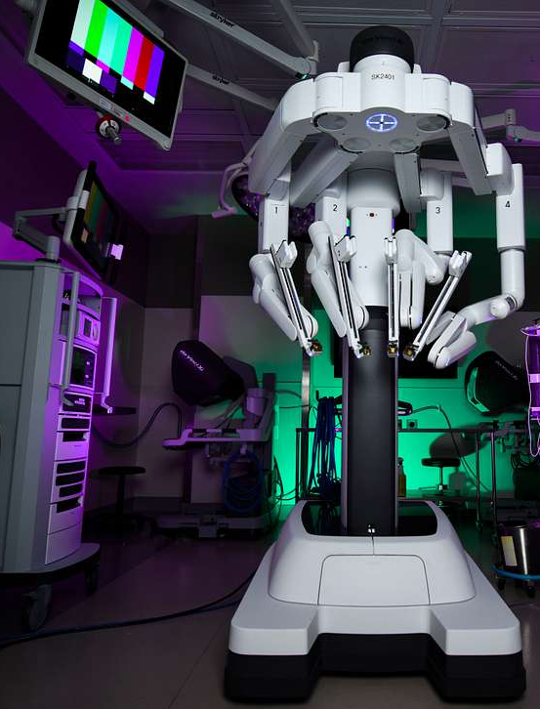
Beneficial Outcomes
Reduction of human error e.g. fatigue (NHS, 2023)
Reducing mortality rates
Repetitive task automation (NHS, 2023)
Giving practitioners more time to spend on patients
Minimally invasive (O’Sullivan et al., 2019)
Quicker recovery
Hostile environments (O’Sullivan et al., 2019)
Avoids spread of infection (O’Sullivan et al., 2019)
STAR robot faster and more consistent than human surgeon (Leonnard et al., 2014)
Da Vinci Surgical System

Slide 5
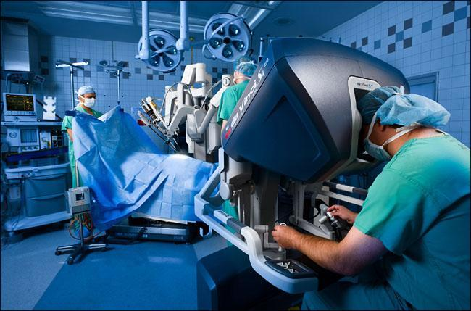
Ethical Principle – Non-maleficence
Non-maleficence is a core principle of medical ethics. It asserts that healthcare providers must avoid causing harm.
Key Components of Non-maleficence (Varkey, 2021):
Preventing Harm: Avoiding intentional or unintentional injury.
Minimizing Risks: Ensuring that any potential harm is minimized to the greatest extent possible.
Relevance to Robotic Surgery: Ensuring that the use of robots in surgery avoids potential harm, such as system malfunctions, human error, and inadequate safety protocols.
Source: Desert West Surgery
www.desertwestsurgery.com/blog/desert-west-surgeons-choose-robotic-surgery-over-traditional-methods

Slide 6
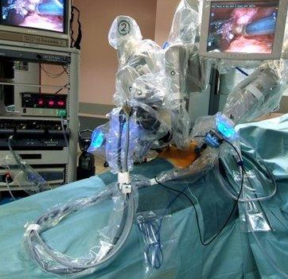
Ethical Concern – Non-maleficence
Robotic surgery linked to 144 deaths in the US
Key Risk Factors Affecting Patient Safety (Shah and Mishra, 2024):
Technological Malfunctions (e.g., system failures during surgery)
Human Error (e.g., improper handling of the robot by inexperienced surgeons)
Inadequate Safety Protocols (e.g., lack of system checks and failure management)
Source: BBC
www.bbc.co.uk/news/technology-33609495

Slide 7




Case Study 1
Cancer Patient Died From Intestinal Tear Caused By Surgical Robot
(Pocharapon, 2024)
Case: According to the suit, in Feb 2022, Sandra Sultzer had abdominal pain and fever before dying of injuries caused by the da Vinci surgical device.
Cause: A malfunctioning robotic arm was unable to complete the procedure properly, leading to significant complications.
Ethical Concern: Was non-maleficence compromised by the hospital’s failure to adequately ensure the technology’s
Source: Huffington Post
www.huffingtonpost.co.uk/entry/cancer-patient-death-lawsuit-surgical-robot-injury_n_65c67ec9e4b093b2e783a327

Slide 8
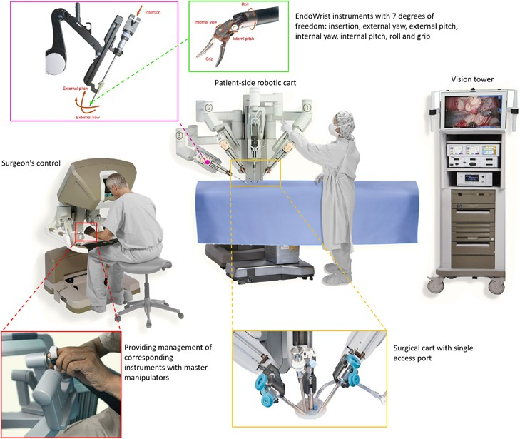



Case Study 2
Robot assisted surgery is blamed for heart patient’s death (Dyer, 2018)
Case: A coroner overseeing an inquest into the death of a 69 years old man after a pioneering robotic heart operation went wrong has concluded that a risk of further deaths.
Cause: The human error. Person doesn’t have experience and lack of training.
Ethical Concern: Was non-maleficence compromised by the hospital’s failure to adequately ensure the technology’s reliability?
Source: Dyer, 2018
https://www.bmj.com/content/363/bmj.k4791

Slide 9

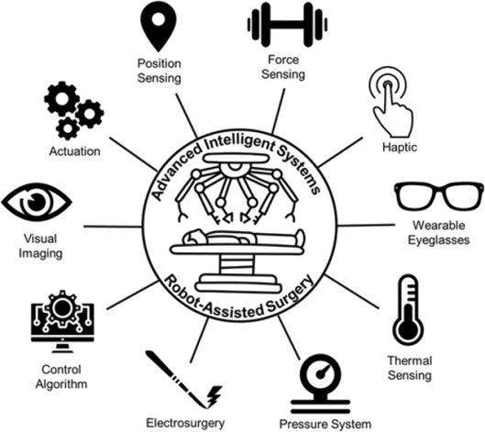




Solutions - Non-maleficence
Rigorous Testing and Certification of robotic systems.
Training Programs for surgeons.
Redundancy Systems to prevent malfunctions during surgery.
Regular Maintenance and Calibration.
Continuous Monitoring During Surgery.
Multidisciplinary Team Collaboration
Source: Wiley Advanced
advanced.onlinelibrary.wiley.com/doi/full/10.1002/aisy.201900138

Slide 10

Recommendations – Non-maleficence
Develop mandatory training programs
Implement failure management protocols
Use continuous monitoring systems
Prioritize Ethical Design and Development

Slide 11
Ethical Concern – Legal Liability
There are questions to be answered regarding the ethical concern of legal liability if things do go wrong.
"Strong link" between legal liability and accountability (O'Sullivan et al., 2019)
Input(s)
Internal State
Output(s)
Accountability for a robot can be achieved given records it can keep:

Slide 12
Ethical Principle – Accountability
O'Sullivan et al. (2019) also outline accountability in this area as "the capacity of a system to give explanation for its actions".
Complexity with accountability in robotic surgery, however, is due to the number of stakeholders involved in the process...
Majority of robotic systems still require a human to control it.
Hospitals
Institutional responsibility.
Manufacturers
Build hardware and develop software.
Surgeons
Staff training
Equipment maintenance
Patient care
Trained
Set training
Meet safety standards
Provide updates
Primary point of treatment
Regulatory Bodies

Slide 13


Case Studies - Accountability
Case Study 1
(Usluoğulları, Tıplamaz and Yaycı, 2017)
Case Study 2
(Pai et al., 2023)
Case Study 3
(Drugwatch, n.d.)
Patient suffered intestinal perforation during robotic-assisted cholecystectomy.
Filed lawsuit hospital's failure to ensure proper certification of training and more.
Case highlighted hospital's liability in credentialing surgeons.
Patient sustained injuries during a robotic hysterectomy.
Claim filed citing inappropriate notification and lack of informed consent regarding training and experience.
Case emphasised the need transparency in medical staff's qualifications.
Range of lawsuits regarding complications in Da Vinci robotic surgery.
Claims that manufacturer was guilty of negligence in producing a defective product.
Included claims of electrical burns, organ damage and death.
Settlements and product recalls.
Image sources:
www.informationweek.com
www.southtees.nhs.uk
www.jupitermed.com

Slide 14



Solutions - Accountability
Stakeholder involvement show convolution with the issue of accountability.
SURGEON TRAINING AND CERTIFICATION
Implement mandatory, standardised training
Newcastle Hospitals NHS Foundation Trust (2023) launch program for surgical trainees
CLEAR LIABILITY AGREEMENTS
Define clear legal responsibilities between stakeholders mentioned - surgeons, hospitals and manufacturers
COMPREHENSIVE INFORMED CONSENT PROCESS
Detailed explanations of the benefits, risks, and potential complications
Royal College of Surgeons of Edinburgh (2021) suggest emphasis on patient-centred

Slide 15



Solutions - Accountability
IMPROVED REGULATION
Strengthen oversight on robotic surgical systems to ensure safer technology.
EU introduced stricter measures in May 2021 for medical devices (Regulation 2017/745).
SYSTEM MALFUNCTION SAFEGUARDS
Implement fail-safe mechanisms to prevent unintended movements, leaks etc.
Dual channel robot control – one checks other for errors (Kang et al., 2003).
ETHICAL AND LEGAL GUIDELINES
Develop legal frameworks for robotic surgery liability.
Majority on case-by-case basis currently - continuing to adapt.
Robotic surgery still a new concept, working in a 'grey area', so improved frameworks for the issues discussed should be established and enforced.

Slide 16
Ethical Concern – The Black-Box Problem
Collins et al., (2022) if a systems reasoning cannot be explained humans cannot determine whether that reasoning is acceptable.
Raposo (2024) explained that the internal workings of black-box systems cannot be accessed by the user or the developer.
This is a challenge for programmers to explain the conclusions that their model has output.
O’Sullivan et al., (2019) highlighted that in the medical domain black-box models do not have high trustworthiness or acceptance within the community.
Changing laws and regulations may make it more difficult to use these models in the future.
Algorithm
Data
Outcome

Slide 17

Ethical Principles – Transparency & Explainability
Transparency
Raposo (2024) - Outlines criteria for transparency in AI systems including disclosing:
The purpose of the model
Data used in training - including whether this is personal or sensitive
Algorithms and development
Performance metrics - accuracy, precision, recall
Biases and their solutions
Human monitoring and responsibility
Legal compliance
Underlying reasoning
Explainability
Boch et al., (2023)
Technical explainability
explaining mathematical weighting and prioritisation of the statistical model
The information that is used to make the decision
Currently no regulations for levels of explainability – GDPR expects data to be processed in a transparent way
Socio-technical explainability
Context for usage

Slide 18



Barriers to Transparency
Hatherley, Sparrow, and Howard (2022) argued that within the field of medical AI Deep learning often has higher accuracy than more interpretable models.
Zhang and Zhang (2023):
Complexity of the algorithms
Non-technical peoples understanding of programming
Trade secrets
Raposo (2024):
Maintaining a competitive advantage – safeguarding algorithms and other intellectual property
Concerns over non-compliance of laws

Slide 19




Solutions - Transparency
Many people have expressed the need for transparency in Surgical AI, however, no regulations or guidelines currently exist for this. Many articles have put forwards ideas about what should be disclosed to aid transparency:
Providing the training data used to create AI algorithms to indicate the model's suitability for the intended population (Collins et al., 2022).
Feedback should be available in real-time during AI driven robotic surgery (Collins et al., 2022).
Incident reports should be available to enable healthcare professionals to report problems with the system (Elendu et al., 2023).

Slide 20


Future Direction - Transparency
Before fully autonomous robotic surgeries can be carried out on humans, a rigid framework needs to be created and agreed upon regarding data and training methods that must be disclosed.
The impact transparent and black-box models must be considered with relation to other ethical concerns.
Collins et al., (2022) highlighted the need for transparency with training data to reduce bias for features such as race or sex.

Slide 21
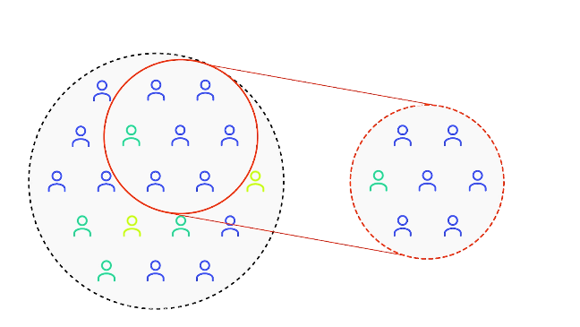

Ethical Concern – Bias
Population
What is bias in AI?
Bias in AI happens when a system produces unfair or prejudiced outcomes, due to flawed data or skewed design (Mittermaier, Raza and Kvedar, 2023).
In healthcare robotics, this can lead to Misdiagnosis or unequal access to precision surgery for certain groups and goes against the UK Equality Act (2010)
k
Ethical Concern – Fairness and Justice
Leads to unequal treatment, misdiagnosis, or reduced access to care for underrepresented patients (Varsha, 2023).
Violates fairness (equal performance across genders/ethnicities) and justice (accountability for harm) (Ueda et al., 2024).
Selection
Selected data does not accurately reflect the entire dataset.
Algorithm learns from biased data leading to errors
Notes:
Importance of bias in healthcare robotics AI?
Healthcare decisions can sometimes be life threatening therefore any mistakes can cost patients their lives (Sergi, 2024).
Robotic surgery systems may perform worse for patients of a specific gender or race (McDermott et al., 2020).
Diagnostic robots may misdiagnose conditions in underrepresented populations (Seyyed-Kalantari et al., 2021).
Ethical Frameworks (from lecture):
Contradicts Asimov’s First Law (avoiding harm).
Fails Equality Act (2010) principles against discrimination."

Slide 22



Causes of Bias
Representation Bias:
Training data is unrepresentative or incomplete
Example: Some Robotics trained mainly on data from younger patients may underperform for older patients (Elendu et al., 2023).
Aggregation Bias:
One-size-fits-all models can distort data for certain subgroups.
Example: Incorrect medication prescribed to patients (Dennis et al., 2022)
Evaluation Bias:
Test Data doesn't not accurately represent real world populations
Example: surgical AI overestimates real-world performance (Obermeyer et al., 2020)
Deployment Bias:
The model's real-world use deviates from its intended purpose.
Example: Surgeons over-relying on robotic systems (Adegbesan et al., 2024).
Notes:
Representation Bias (Representation Bias):
Data Representation occurs when the training data used for AI/Machine learning systems is unrepresentative or incomplete (Ferrara, 2024).
Example: A diagnostic tool trained mainly on data from younger patients may underperform for older patients (Elendu et al., 2023).
Evaluation Bias:
Test Data doesn't not accurately represent real world populations
Example: surgical AI tested on narrow datasets overestimates real-world performance (Obermeyer et al., 2020)
Deployment Bias:
Mismatch between how the model is designed and how it’s used in real-world settings.
Example: Surgeons over-relying on robotic systems as autonomous tools (vs. assistive).
Human Bias:
Human decisions in data collection, labelling, and model design can introduce bias (Chen et al., 2023).
Example: Subjective labelling of medical images can lead to inconsistent or unfair outcomes (Koçak et al., 2024).
historical bias Past inequalities in healthcare access skew training data

Slide 23


Case Studies – Bias/Fairness
Case Study 1
(Denecke and Baudoin, 2022)
Case Study 2
(Albahri et al., 2023)
Case Study 3
(Pedrett et al., 2023)
AI surgical robots enhance precision in procedures like minimally invasive surgery.
Underrepresented groups such as minorities in training data lead to unequal outcomes.
Models favour majority groups due to imbalanced data or flawed design.
Surgeons’ unconscious preferences skew AI.
Solutions are to use diverse datasets, explainable AI, and bias audits.
Training data underrepresent genders or rare anatomies, leading to unequal robotic performance.
AI-driven surgical robots may prioritize certain techniques (e.g., minimally invasive) based on training data
Lack of transparency
Solutions are to use bias audits for surgical AI.
AI assesses surgical skills in minimally invasive procedures. Performs well in test but suffers in real world.
Only 8 of 50 studies had low risk of bias. Issues included small datasets and lack of diverse testing.
Few models were tested outside their original setting. This makes real world performance uncertain.
Solutions are to use clearer testing methods and real-world trials to improve reliability.
Notes:
Case Study 3:
Most research uses data from robotic tools like the Da Vinci system. Tasks like suturing and knot-tying are common in training simulations.
Limited Participants – Many studies used small groups of surgeons (e.g., only experts or trainees from one institution).
Similar Surgical Cases – Tests often focused on repetitive tasks (like suturing in a simulator) rather than varied real surgeries.
Few Real-World Settings – Most models weren’t checked in different hospitals or on different patient populations.
Use Larger, Varied Datasets
Improve Study Design
Increase Transparency
Continuous Monitoring
Standardized Evaluation
Case Study 2:
Diverse datasets (multi-institutional surgical data)
Explainability tools (e.g., SHAP values to audit AI decisions)
Human-AI collaboration (surgeons override biased recommendations)
Technique Bias
Definition: AI-driven robots Favor certain surgical methods (e.g., minimally invasive) due to skewed training data.
Transparency Bias
Definition: Lack of clarity in how robotic systems make decisions (linked to Black Box Problem in lecture).
Case Study 1:
AI-powered surgical robots assist with real-time navigation, decision-making, and precision tasks in procedures like minimally invasive surgery.
Bias risks emerge when training data underrepresents certain groups (women, ethnic minorities, rare anatomies), leading to worse outcomes for these patients.
Algorithmic bias occurs when models Favor majority populations due to imbalanced datasets or flawed design choices in the AI system.
Human bias can be amplified when surgeons' unconscious preferences get embedded into AI tools through data labelling or system training.
Mitigation requires diverse training datasets, explainable AI models, and multidisciplinary teams to audit systems for fairness before clinical use.
Case Study 1:
AI and Robotics in Healthcare: AI enhances diagnostics, decision-making, and personalized medicine, while robotics assists in surgeries, rehabilitation, and patient care (e.g., robotic exoskeletons, surgical robots).
Key Applications: Includes robotic surgery (minimally invasive procedures), AI-driven diagnostics (sepsis prediction, tumor detection), telemedicine (chatbots, remote monitoring), and precision medicine (genomic data analysis).
Challenges: Bias in AI models (due to unrepresentative data), lack of transparency ("black box" algorithms), and ethical concerns (privacy, accountability) hinder widespread adoption.
Future Focus: Requires addressing bias, improving explainability, ensuring interoperability, and establishing ethical frameworks to build trust and integrate AI/robotics into healthcare effectively.

Slide 24

Solutions - Bias/Fairness
Diverse Training Data
Use datasets covering age, gender, race, and rare conditions (Knudsen et al., 2024).
Bias Testing
Use fairness metrics like equal accuracy, demographic parity, and equal opportunity (Sufian et al., 2024).
Regulation and Standards
Enforce policies requiring yearly bias audits (Siala and Wang, 2022).
Inclusive Design Teams
Involve diverse teams of developers, engineers , and ethicists in the design process, (Ienca, Valle and Raspopovic, 2025).
Notes:
Diverse Training Data
Train surgical AI on diverse patient data (gender, age, race, conditions) to reduce bias (Knudsen et al., 2024).
Bias Testing and Auditing
Regularly test AI systems for bias using fairness metrics like equal accuracy, demographic parity, and equal opportunity (Sufian et al., 2024).
Inclusive Design Teams
Involve diverse teams of developers, clinicians, and ethicists in the design process, (Ienca, Valle and Raspopovic, 2025).
Regulation and Standards
Enforce policies requiring yearly bias audits for medical AI systems (Siala and Wang, 2022).
Diverse Training Data
Train robotic surgery systems with more diverse data collected from a wide range of patient groups, including different genders, ages, races, and medical conditions (Knudsen et al., 2024).
Bias Testing and Auditing
Regularly test AI systems for bias using fairness metrics like equal accuracy, demographic parity, and equal opportunity, and evaluate rehabilitation robots for performance gaps between younger and older patients (Sufian et al., 2024).
Inclusive Design Teams
Involve diverse teams of developers, clinicians, and ethicists in the design process, and include input from disabled patients when developing AI-powered prosthetics (Ienca, Valle and Raspopovic, 2025).
Regulation and Standards
Advocate for policies that enforce fairness and accountability in AI-driven healthcare systems, requiring hospitals to audit robotic systems annually for bias (Siala and Wang, 2022).
Transparent Algorithms
Use explainable AI (XAI) techniques to make decision-making clear and understandable, allowing doctors to see how AI-powered prosthetics adapt to user movements (Antoniadi et al., 2021).

Slide 25
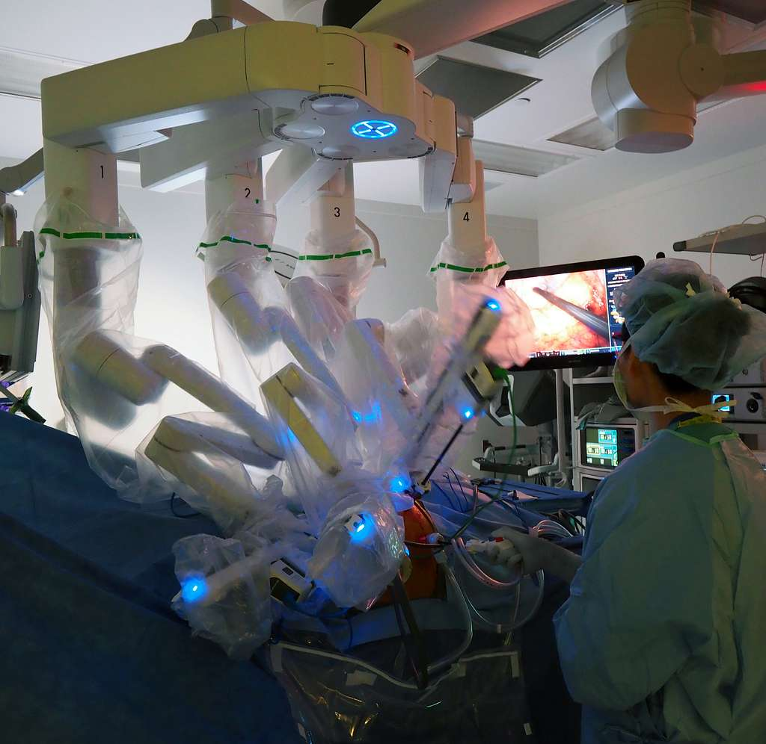
Future Direction – Bias/Fairness
Train model with various surgical skills
Future research should focus on addressing AI bias across all surgical skills (Kiyasseh et al., 2023).
Transparent Algorithms
Develop explainable AI (XAI) tools to make robotic decision-making transparent (Praveenraj et al., 2023).
Use of software such as TWIX
TWIX reduces bias in surgical AI by prioritizing key video clips for skill assessment (Mittermaier, Raza and Kvedar, 2023).
Gather more varied data
Diversifying datasets reduce AI bias. However, this requires stricter privacy safeguards and stronger security.
Notes:
Future research should evaluate and address bias in AI systems that assess a wider range of surgical skills, ensuring fairness across all areas of surgical performance (Kiyasseh et al., 2023).
Twix to help mitigate bias in healthcare robotics ai - teaches the AI to predict the importance of video clips used for assessing surgical skills (Mittermaier, Raza and Kvedar, 2023).
TWIX is an add-on module designed to reduce bias in AI models that assess surgical skills from video data (e.g., robotic surgery recordings). Predicts importance of video clips same as humans
Expanding datasets to include more diverse patient groups can reduce bias in AI systems. However, this requires stronger security measures to protect patient privacy and ensure data safety (Norori et al., 2021).
Integrate robotics with Virtual Reality in rehabilitation to offer stroke patients more engaging and personalized therapy (Maranesi et al., 2021).

Slide 26

Ethical Principal – Security and Safety
Security
Protecting robotic surgery systems from cyberattacks and unauthorized access.
Safety
Ensuring the physical well-being of patients by preventing system malfunctions and human errors.
Source: European Commission
digital-strategy.ec.europa.eu/en/library/cybersecurity-hospitals-and-healthcare-providers

Slide 27

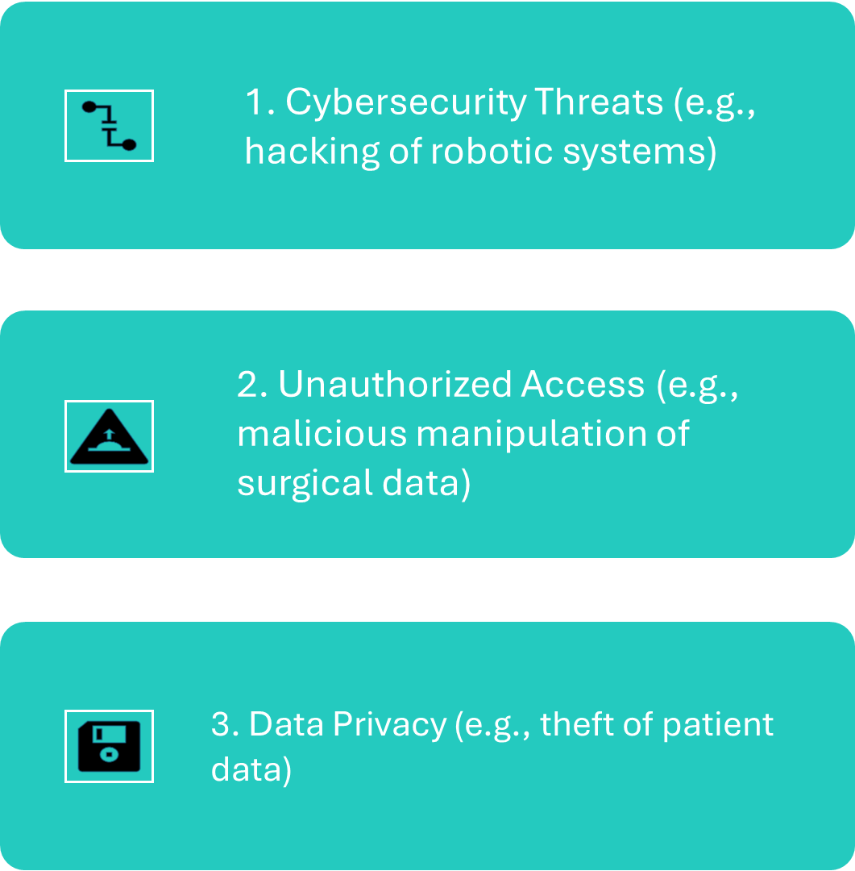
Ethical Concerns – Security Challenges
Source: Dr. Praveen Kammar
drpraveenkammar.com/blogs/is-robotic-surgery-safe-for-cancer/

Slide 28

Ethical Concerns – Safety Challenges
System Failures (e.g., robotic arm malfunctions during surgery)
Human Error (e.g., improper use of robotic controls)
Lack of Redundancy (e.g., no backup or manual override)
https://ntxsurgical.com/safety-in-robotic-surgeries-protocols-and-practices-to-protect-patients/

Slide 29

Solutions – Safety and Security
Enhanced Cybersecurity Protocols (e.g., encryption, authentication)
Safety Features and Redundancy (e.g., backup systems, emergency shutdown)
Regular Testing and Updates (e.g., system audits and safety checks)
Source: Automation
www.automation.com/en-us/articles/july-2024/cybersecurity-risks-surgical-robots-healthcare

Slide 30
Future Direction - Safety and Security
Implement robust cybersecurity measures.
1
Regular maintenance and updates for robotic systems.
2
Comprehensive training for surgeons and staff.
3

Slide 31

Conclusion
AI-powered robotic surgery improves precision, efficiency, and patient outcomes.
Systems like Da Vinci and other innovations have transformed healthcare.
Ethical challenges must be addressed for responsible implementation.
The future requires a balance between innovation, safety, and accessibility.
The future of healthcare lies in smarter, safer, and more efficient medical technologies.

Slide 32

Thank You!!!
References are below
Your Questions and Queries are most welcome

Slide 33
References
Adegbesan, A., Akingbola, A., Aremu, O., Adewole, O., Amamdikwa, J.C. and Shagaya, U. (2024) ‘From Scalpels to Algorithms: The Risk of Dependence on Artificial Intelligence in Surgery’, Journal of Medicine, Surgery, and Public Health, 3, p. 100140. Available at: https://doi.org/10.1016/J.GLMEDI.2024.100140.
Albahri, A.S., Duhaim, A.M., Fadhel, M.A., Alnoor, A., Baqer, N.S., Alzubaidi, L., Albahri, O.S., Alamoodi, A.H., Bai, J., Salhi, A., Santamaría, J., Ouyang, C., Gupta, A., Gu, Y. and Deveci, M. (2023) ‘A systematic review of trustworthy and explainable artificial intelligence in healthcare: Assessment of quality, bias risk, and data fusion’, Information Fusion, 96, pp. 156–191. Available at: https://doi.org/10.1016/j.inffus.2023.03.008.
Alrawi, A. (2018) The Da Vinci Medical Robot and AI. Available at: https://electronichealthreporter.com/the-da-vinci-medical-robot-and-ai/ (Accessed 7 March 2025)
Boch, A., Ryan, S., Kriebitz, A., Amugongo, L.M. and Lütge, C. (2023) ‘Beyond the Metal Flesh: Understanding the Intersection between Bio- and AI Ethics for Robotics in Healthcare’, Robotics (Basel), 12(4), pp. 110-. Available at: https://doi.org/10.3390/robotics12040110.
Collins, J.W., Marcus, H.J., Ghazi, A., Sridhar, A., Hashimoto, D., Hager, G., Arezzo, A., Jannin, P., Maier-Hein, L., Marz, K., Valdastri, P., Mori, K., Elson, D., Giannarou, S., Slack, M., Hares, L., Beaulieu, Y., Levy, J., Laplante, G., Ramadorai, A., Jarc, A., Andrews, B., Garcia, P., Neemuchwala, H., Andrusaite, A., Kimpe, T., Hawkes, D., Kelly, J.D. and Stoyanov, D. (2022) ‘Ethical implications of AI in robotic surgical training: A Delphi consensus statement’, European urology focus, 8(2), pp. 613–622. Available at: https://doi.org/10.1016/j.euf.2021.04.006.
Denecke, K. and Baudoin, C.R. (2022) ‘A Review of Artificial Intelligence and Robotics in Transformed Health Ecosystems’, Frontiers in Medicine, 9. Available at: https://doi.org/10.3389/fmed.2022.795957.
Dennis, J.M., Young, K.G., McGovern, A.P., Mateen, B.A., Vollmer, S.J., Simpson, M.D., Henley, W.E., Holman, R.R., Sattar, N., Pearson, E.R., Hattersley, A.T., Jones, A.G. and Shields, B.M. (2022) ‘Development of a treatment selection algorithm for SGLT2 and DPP-4 inhibitor therapies in people with type 2 diabetes: a retrospective cohort study’, The Lancet Digital Health, 4(12), pp. e873–e883. Available at: https://doi.org/10.1016/S2589-7500(22)00174-1.
Drugwatch (n.d.) Da Vinci Surgery Lawsuits. Available at: https://www.drugwatch.com/davinci-surgery/lawsuits/ [Accessed 17 March 2025].
Dyer, C. (2018) ‘Robot assisted surgery is blamed for heart patient’s death’, BMJ (Online), 363, pp. k4791–k4791. Available at: https://doi.org/10.1136/bmj.k4791.

Slide 34
References
Elendu, C., Amaechi, D.C., Elendu, T.C., Jingwa, K.A., Okoye, O.K., John Okah, M., Ladele, J.A., Farah, A.H. and Alimi, H.A. (2023) ‘Ethical implications of AI and robotics in healthcare: A review’, Medicine (Baltimore), 102(50), pp. e36671–e36671. Available at: https://doi.org/10.1097/MD.0000000000036671.
George, E.I., Brand, T.C., LaPorta, A., Marescaux, J. and Satava, R.M., 2018. Origins of robotic surgery: From skepticism to standard of care. JSLS: Journal of the Society of Laparoendoscopic Surgeons, 22(4), p.e2018.00039. Available at: https://doi.org/10.4293/JSLS.2018.00039
Hatherley, J., Sparrow, R. and Howard, M. (2022) ‘The Virtues of Interpretable Medical Artificial Intelligence’, Cambridge quarterly of healthcare ethics, pp. 1–10. Available at: https://doi.org/10.1017/S0963180122000305.
Ienca, M., Valle, G. and Raspopovic, S. (2025) ‘Clinical trials for implantable neural prostheses: understanding the ethical and technical requirements’, The Lancet Digital Health [Preprint]. Elsevier Ltd. Available at: https://doi.org/10.1016/S2589-7500(24)00222-X.
Kang, H., Lee, J., Kim, Y., & Kim, J. (2003) 'A fail-safe dual channel robot control for surgery applications', Reliability Engineering & System Safety, 80(3), pp. 331–337. Available at: https://doi.org/10.1016/S0925-7535(03)00080-8 (Accessed: 26 March 2025).
Kiyasseh, D., Laca, J., Haque, T.F., Otiato, M., Miles, B.J., Wagner, C., Donoho, D.A., Trinh, Q.-D., Anandkumar, A. and Hung, A.J. (2023) ‘Human visual explanations mitigate bias in AI-based assessment of surgeon skills’, npj Digital Medicine, 6(1). Available at: https://doi.org/10.1038/s41746-023-00766-2.
Knudsen, J.E., Ghaffar, U., Ma, R. and Hung, A.J. (2024) ‘Clinical applications of artificial intelligence in robotic surgery’, Journal of Robotic Surgery. Springer Nature. Available at: https://doi.org/10.1007/s11701-024-01867-0.
Leonard, S., Wu, K.L., Kim, Y., Krieger, A. and Kim, P.C.W. (2014) ‘Smart Tissue Anastomosis Robot (STAR): A Vision-Guided Robotics System for Laparoscopic Suturing’, IEEE transactions on biomedical engineering, 61(4), pp. 1305–1317. Available at: https://doi.org/10.1109/TBME.2014.2302385.
Mittermaier, M., Raza, M.M. and Kvedar, J.C. (2023) ‘Bias in AI-based models for medical applications: challenges and mitigation strategies’, npj Digital Medicine. Nature Research. Available at: https://doi.org/10.1038/s41746-023-00858-z.

Slide 35
References
Newcastle Hospitals NHS Foundation Trust (2023) 'UK’s first robotic surgery training programme for surgical trainees launched in the North East'. Available at: https://www.newcastle-hospitals.nhs.uk/news/uks-first-robotic-surgery-training-programme-launched-in-the-north-east/ (Accessed: 23 March 2025).
NHS (2023) The impact of Artificial Intelligence (AI). Available at: https://digital-transformation.hee.nhs.uk/building-a-digital-workforce/dart-ed/horizon-scanning/ai-and-digital-healthcare-technologies/introduction/the-impact-of-ai (Accessed: 25 March 2025).
Obermeyer, Z. et al. (2020) Dissecting racial bias in an algorithm used to manage the health of populations. Available at: http://science.sciencemag.org/.
O’Sullivan, S., Nevejans, N., Allen, C., Blyth, A., Leonard, S., Pagallo, U., Holzinger, K., Holzinger, A., Sajid, M.I. and Ashrafian, H. (2019) ‘Legal, regulatory, and ethical frameworks for development of standards in artificial intelligence (AI) and autonomous robotic surgery’, The international journal of medical robotics + computer assisted surgery, 15(1), pp. e1968-n/a. Available at: https://doi.org/10.1002/rcs.1968.
Pai, S. N., Jeyaraman, M., Jeyaraman, N., Nallakumarasamy, A., and Yadav, S. (2023) ‘In the Hands of a Robot, From the Operating Room to the Courtroom: The Medicolegal Considerations of Robotic Surgery’, Cureus, 15(8), e43634. doi: 10.7759/cureus.43634.
Pedrett, R., Mascagni, P., Beldi, G., Padoy, N. and Lavanchy, J.L. (2023) ‘Technical skill assessment in minimally invasive surgery using artificial intelligence: a systematic review’, Surgical Endoscopy. Springer, pp. 7412–7424. Available at: https://doi.org/10.1007/s00464-023-10335-z.
Pocharapon. (2024). Cancer patient’s death sparks lawsuit over surgical robot injury. [online] 8 Feb. Available at: https://www.huffingtonpost.co.uk/entry/cancer-patient-death-lawsuit-surgical-robot-injury_n_65c67ec9e4b093b2e783a327.
Praveenraj, D.D.W., Victor, M., Vennila, C., Hussein Alawadi, A., Diyora, P., Vasudevan, N. and Avudaiappan, T. (2023) ‘Exploring Explainable Artificial Intelligence for Transparent Decision Making’, in E3S Web of Conferences. EDP Sciences. Available at: https://doi.org/10.1051/e3sconf/202339904030.
Raposo, V.L. (2024) ‘How is ʻUnexplainable’ and Non-transparent AI Affecting Healthcare Delivery?’, Oslo law review, 11(1), pp. 1–12. Available at: https://doi.org/10.18261/olr.11.1.6.
Royal College of Surgeons of Edinburgh (RCSEd) (2021) 'Development of new robotic surgical services: A guide to good practice'. Available at: https://www.rcsed.ac.uk/media/lhibabqc/rcsed-robotics-guidance-document-final.pdf (Accessed: 25 March 2025).

Slide 36
References
Shah, I.A. and Mishra, S. (2024) ‘Artificial intelligence in advancing occupational health and safety: an encapsulation of developments’, Journal of Occupational Health, 66(1), uiad017. Available at: https://doi.org/10.1093/JOCCUH/uiad017.
Siala, H. and Wang, Y. (2022) ‘SHIFTing artificial intelligence to be responsible in healthcare: A systematic review’, Social Science and Medicine, 296. Available at: https://doi.org/10.1016/j.socscimed.2022.114782.
Sufian, M.A., Alsadder, L., Hamzi, W., Zaman, S., Sagar, A.S.M.S. and Hamzi, B. (2024) ‘Mitigating Algorithmic Bias in AI-Driven Cardiovascular Imaging for Fairer Diagnostics’, Diagnostics, 14(23). Available at: https://doi.org/10.3390/diagnostics14232675.
The Surgical Clinic. (n.d.). The History of Robot-Assisted Surgery. [online] Available at: https://thesurgicalclinics.com/history-of-robot-assisted-surgery/ [Accessed 21 Mar. 2025].
Ueda, D., Kakinuma, T., Fujita, S., Kamagata, K., Fushimi, Y., Ito, R., Matsui, Y., Nozaki, T., Nakaura, T., Fujima, N., Tatsugami, F., Yanagawa, M., Hirata, K., Yamada, A., Tsuboyama, T., Kawamura, M., Fujioka, T. and Naganawa, S. (2024) ‘Fairness of artificial intelligence in healthcare: review and recommendations’, Japanese Journal of Radiology. Springer, pp. 3–15. Available at: https://doi.org/10.1007/s11604-023-01474-3.
Ugalde, M. (2023) The Da Vinci System: A Feat in Medicine, a Newfound Dilemma in the Legal Field. Available at: https://jolt.richmond.edu/2023/11/17/the-da-vinci-system-a-feat-in-medicine-a-newfound-dilemma-in-the-legal-field/ (Accessed: 21 March 2025).
Usluoğulları, F. H., Tıplamaz, S., and Yaycı, N. (2017) ‘Robotic surgery and malpractice’, Turkish Journal of Urology, 43(4), pp. 425–428. doi: 10.5152/tud.2017.59013.
Varkey, B. (2021) ‘Principles of clinical ethics and their application to practice’, Medical Principles and Practice, 30, pp. 17–28. Available at: https://doi.org/10.1159/000509119.
Varsha P.S. (2023) ‘How can we manage biases in artificial intelligence systems – A systematic literature review’, International Journal of Information Management Data Insights, 3(1). Available at: https://doi.org/10.1016/j.jjimei.2023.100165.
Zhang, J. and Zhang, Z.-M. (2023) ‘Ethics and governance of trustworthy medical artificial intelligence’, BMC medical informatics and decision making, 23(1), pp. 7–7. Available at: https://doi.org/10.1186/s12911-023-02103-9.

